Slide 1
Viewpoint-based Streaming & Compression for VR
Asa Hayes

Slide 2

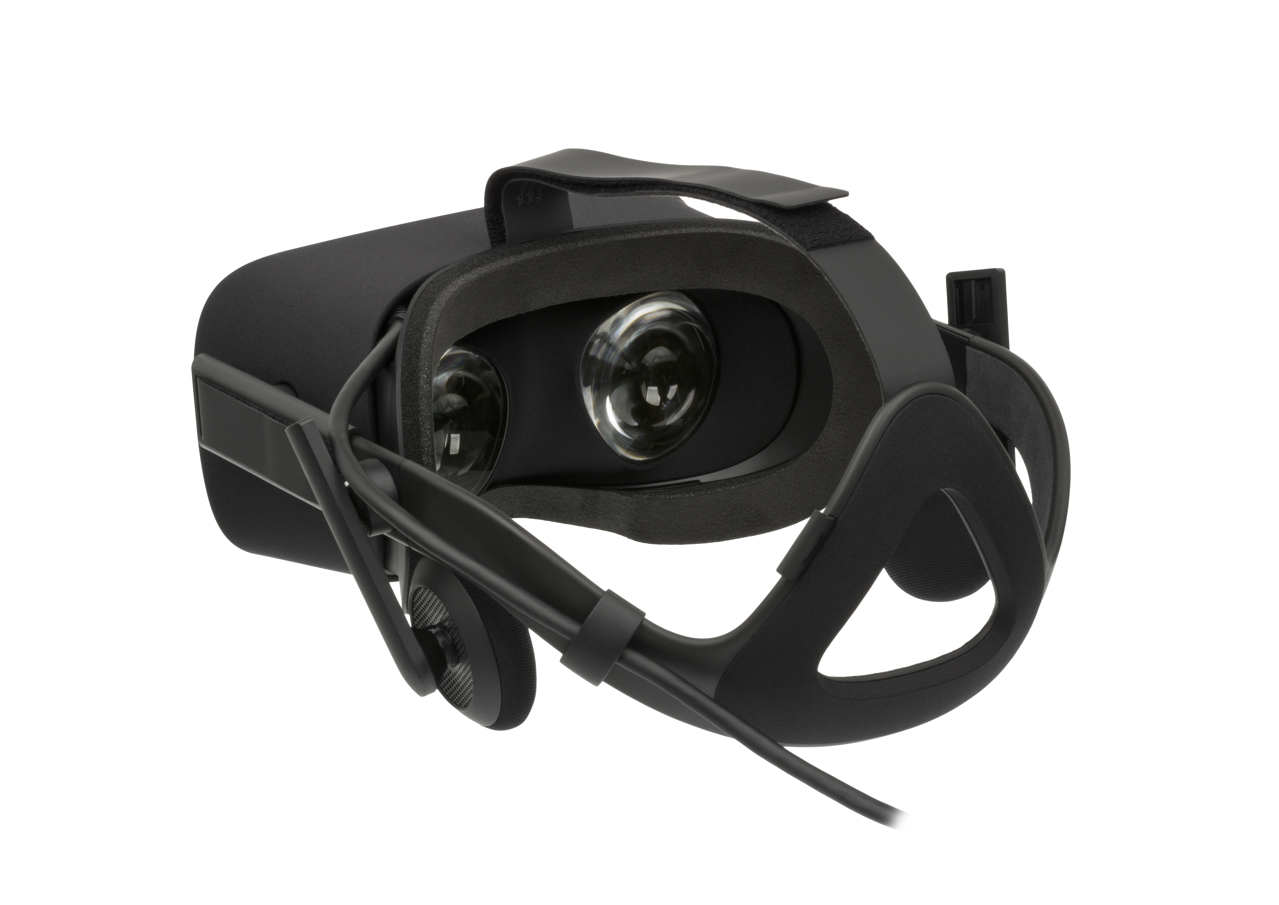
Purpose
VR video streaming for all applications is costly.
But, VR demands visible high definition to work properly.
Methods are needed to optimize streaming without sacrificing the user’s vision.
Approach: Have only the area the user sees be in HD.
Oculus Rift CV1, from Wikipedia

Slide 3
Implementation
Split the total 360° video into 2 areas: the user’s FOV and everywhere else.
Use the directional sensors in the headset to find the FOV.
Keep video inside the FOV at full/high resolution, downsample the rest to save resources.
Heavily reduces amount of data being streamed, more ability for VR on lower system specs.

Slide 4
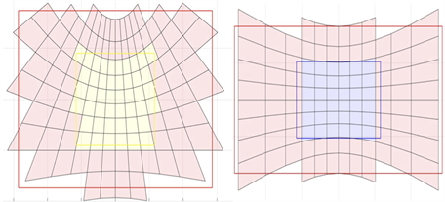
For precise control over what areas are allocated certain resolutions, split the whole video into a grid of sub-videos. Each grid-square of video can be independently downsampled if not within the FOV.
Grid-based format also helps with determination of which squares in the matrix do fall within the FOV by way of vertices.

Slide 5
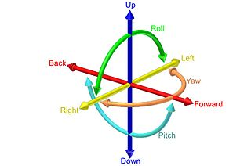
Decision Algorithm
To chose the proper grid-squares, we first need to determine the size & location of the FOV.
FOV can be found from the current position of the headset, with components yaw, pitch, & roll.
Orienatation Diagram, from Wikimedia Commons

Slide 6
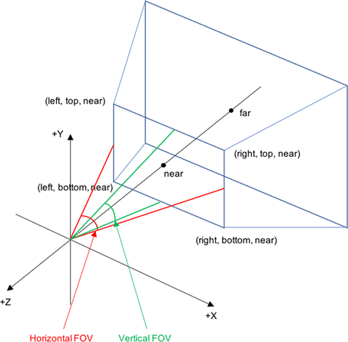
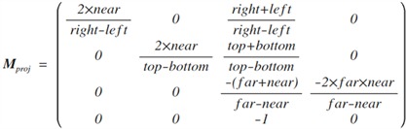
From position components, 2 matrices are created: one each for projection & rotation.
The projection matrix creates a rectangle that projects onto the grid, which represents the user’s entire FOV, but is not oriented to the headset’s viewpoint.
The rotation matrix orients the FOV area to the user’s viewpoint.

Slide 7
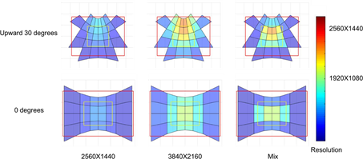
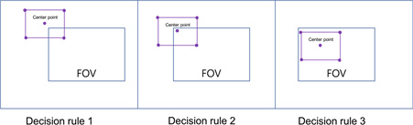
Once the FOV is created and aligned, the decision on which grid-squares are prioritized is simple.
All grid-squares not in the FOV are downscaled more the further they are from the FOV.

Slide 8
Impact
This technique reduces streaming & hardware load, making it less expensive to run VR.
Less expense in VR leads to greater adoption, development, and applications to meet the growing market.
VR could grow to be more than just 90% games.

Slide 9
Based on Journal Article:
Kim, S. , Yun, J. , Jo, B. , Kim, J. , Chae, H. and Suh, D. (2018) View Direction Adaptive 360 Degree Video Streaming System Based on Projected Area. Journal of Computer and Communications, 6, 203-212. doi: 10.4236/jcc.2018.61020.
All images are from this article unless otherwise specified. Other images used are labelled free for non-commercial use.

